Slide 1
Workshop 6 – Renewable Energy, Conservation and Management
Resilient Housing Design in Fragile Settings
Narmeen Aamir
Fulbright Fellow, Illinois Institute of Technology; Co-founder, Chabitech

Slide 2
Part I

Slide 3
What is Zero Energy House?
Goal: produce as much energy, through renewable sources, as the home consumes in a year
Net zero utility bills.
Notes:
Zero energy homes are not ultra-modern or strange looking. You could walk right by a zero-energy home and never know it. They simply require careful planning, some specialized construction techniques to make them super energy efficient, and installing the correct energy efficient systems and appliances in the home

Slide 4
What is the need for it?
Reduction in green house emissions
Self-reliance in energy
Lesser load on the grids
Stability of over all system.

Slide 5
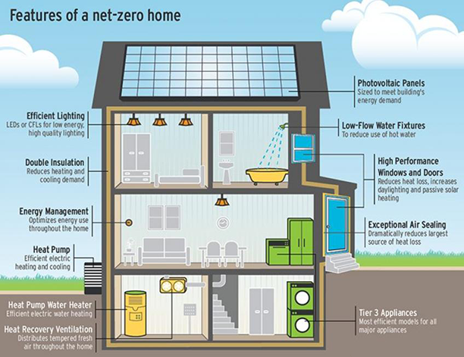
How to design Electrical System for ZEH?

Slide 6
Strategical Approach
Choose an appropriate site (ample solar energy/wind energy)
Daylight saving techniques
Energy efficient lighting
Energy efficient appliances
Solar heating
Insulation
Add-ons
PV panels

Slide 7
Daylight Savings
Remember the ancient times
Daylight discussed in the holy scripture (Al-Kahf)
Daylight saving time
EnergyPlus software has the capability to analyze daylight and energy flow in buildings
Roof domes affect the energy required for lighting, heating and cooling
Use of mirrors
Choosing colors for the rooms
https://ieeexplore.ieee.org/document/7062436
https://ieeexplore.ieee.org/document/7346975

Slide 8
Energy Efficient Lighting
Light emitting diodes (LEDs), Compact fluorescent light (CFLs)
Choose appropriate Lux levels (DiaLUX)
Soil lamps?
Notes:
Model the sunlight by some bulb/light in dialux, then calculate lux for the room with minimum watts bulbs.
The lux (symbol: lx) is the unit of illuminance, or luminous flux per unit area

Slide 9
Solar Heating
Solar hot water heater
Collects heat as the sun shines through south-facing windows and retains it in materials that store heat, known as thermal mass. What about sunlight in summers?
Indirect circulation systems Pumps circulate a non-freezing, heat transfer fluid through the collectors and a heat exchanger. This heats the water that then flows into the home. They are popular in climates prone to freezing temperatures.
Notes:
Using the sun for heating through south facing windows during the winter lowers heating costs. Shading those same windows in summer lowers cooling costs. Solar tempering aims to optimize this passive use of the sun’s heat, without incurring the added cost of thermal mass needed to achieve maximum passive solar heating. Solar tempering should be addressed in the design phase.

Slide 10
Good Insulation
Isolating the outer environment from inside
Lower effort required to maintain desired temperature
Lesser impact of heat/cold from outside

Slide 11
Energy Management
Running appliances at off-peak hours
“straightening the curve”
The Home Energy Manager is designed to control and optimize on-site energy generation and consumption, such as by running the dishwasher or clothes dryer at times when the solar panels are operating, and not during peak times

Slide 12
Energy Efficient Appliances
Tier 3,4
CEE Advanced Tier Rating
Energy Star Rating

Slide 13
Smart Appliances/Devices
The use of BMS (Building Management System)
Easy peasy: IoT
You can apply scheduling based on certain scenarios
For example: Automate shades/drapes for daylight harvesting to minimize the need for electric lights during the day
Notes:
Schedule connected appliances to operate when electricity generation is plentiful – such as running the dishwasher during the middle of the day while the homeowners are at work.
Automate blinds/shades to minimize solar gain in the summer and leverage passive solar to help heat the home in the winter

Slide 14
Home Energy Monitoring
2 ways
Only monitoring
How much energy is used.
The owner has control (turning motors off yourself if usage is high).
Monitoring and controlling
The system is intelligent enough to monitor and control itself.

Slide 15
Part II - Renewable Energies

Slide 16
Geo Thermal
Geothermal resources are reservoirs of hot water that exist at varying temperatures and depths below the Earth's surface. Mile-or-more-deep wells can be drilled into underground reservoirs to tap steam and very hot water that can be brought to the surface for use in a variety of applications, including electricity generation, direct use, and heating and cooling. In the United States, most geothermal reservoirs are located in the western states.
https://www.energy.gov/eere/geothermal/geothermal-basics

Slide 17
Hydro Power
Hydropower, or hydroelectric power, is a renewable source of energy that generates power by using a dam or diversion structure to alter the natural flow of a river or other body of water. Hydropower relies on the endless, constantly recharging system of the water cycle to produce electricity, using a fuel—water—that is not reduced or eliminated in the process. There are many types of hydropower facilities, though they are all powered by the kinetic energy of flowing water as it moves downstream. Hydropower utilizes turbines and generators to convert that kinetic energy into electricity, which is then fed into the electrical grid to power homes, businesses, and industries.
https://www.energy.gov/eere/water/how-hydropower-works

Slide 18
Wind Energy
A wind turbine turns wind energy into electricity using the aerodynamic force from the rotor blades, which work like an airplane wing or helicopter rotor blade. When wind flows across the blade, the air pressure on one side of the blade decreases. The difference in air pressure across the two sides of the blade creates both lift and drag. The force of the lift is stronger than the drag and this causes the rotor to spin. The rotor connects to the generator, either directly (if it’s a direct drive turbine) or through a shaft and a series of gears (a gearbox) that speed up the rotation and allow for a physically smaller generator. This translation of aerodynamic force to rotation of a generator creates electricity.
https://www.energy.gov/eere/wind/how-do-wind-turbines-work

Slide 19
Solar Energy
Sunlight when falls on the Photo Voltaic panels, produce voltage as a result of photo -electric effect.
Clean but unreliable. Really?

Slide 20
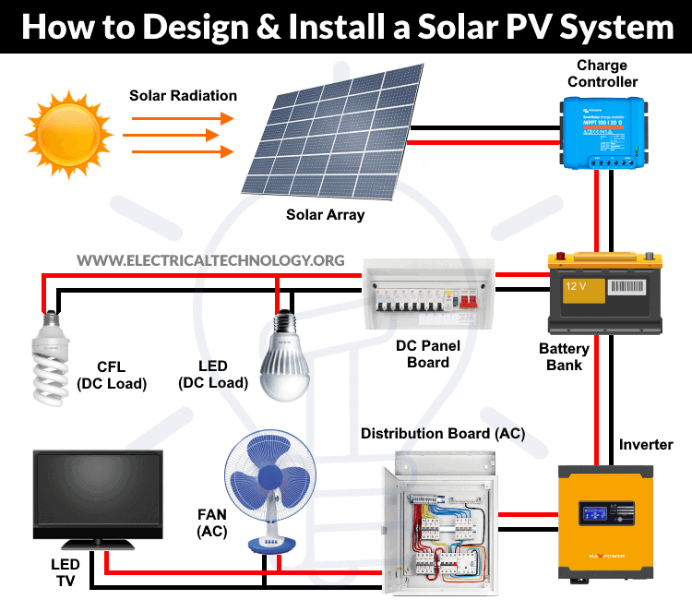
PV System Design

Slide 21
Components Required
Solar Panels
Charge Controller
Battery
Inverter
Other Accessories
Frame for panel fitting
Distribution board, bus bar, connectors, breakers and Cables

Slide 22
Panel Mounting
Rack Mounting
Building-Integrated PV (BIPV).
Ideally the radiation angle must be perpendicular to the PV panel and practically as close as to 90 degrees.
Panels should be facing south for northern hemisphere countries.

Slide 23
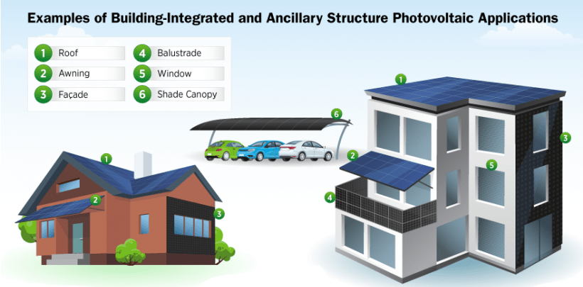

Slide 24
Inverters
DC-AC conversion
One inverter VS. Micro inverters
“Smart inverters" for two-way communication between the inverter and the electrical utility. This can help balance supply and demand either automatically or via remote communication with utility operators

Slide 25
Batteries
Batteries allow for the storage of solar photovoltaic energy, so we can use it to power our homes at night or when weather elements keep sunlight from reaching PV panels. Not only can they be used in homes, but batteries are playing an increasingly important role for utilities. As customers feed solar energy back into the grid, batteries can store it so it can be returned to customers at a later time. The increased use of batteries will help modernize and stabilize our country's electric grid

Slide 26
Maximum Efficiency of Panels
There are two conditions for maximum efficiency from PV panels. 1) PV open circuit voltage should be greater than battery bank terminal voltage i.e. Voc > Vb 2) Voltage difference between PV open circuit voltage and battery should be minimal.
Therefore, 100 watt panel which has an open circuit voltage of 16V is recommend because it has 13V for 90% day time

Slide 27
Types of Batteries
Lead Acid
Gel Type
Dry Type
Notes:
Flooded
Sealed. These are also called valve-regulated lead-acid (VRLA) or sealed lead-acid (SLA) batteries
On the other hand, sealed batteries have a solid electrolyte.

Slide 28
Depth of Discharge
For example we have 100 Ah battery and depth of discharge is 20% it means that 20 ampere current could be discharged
Flooded battery perform best on 20% depth of discharge
Dry type has 50% depth of Discharge
Gel type has around 80% depth of Discharge
Notes:
A battery’s depth of discharge (DoD) indicates the percentage of the battery that has been discharged relative to the overall capacity of the battery. Depth of Discharge is defined as the capacity that is discharged from a fully charged battery, divided by battery nominal capacity. Depth of discharge is normally expressed as a percentage. For, example, if a 100 A h battery is discharged for 20 minutes at a current of 50 A, the depth of discharge is 50 * 20 / 60 / 100 = 16.7 %.
The more frequently a battery is charged and discharged, the shorter its lifespan will be. It’s generally not recommended to discharge a battery entirely, as that dramatically shortens the useful life of the battery. Many battery manufacturers specify a maximum recommended DoD for optimal performance.

Slide 29
Calculations
Let’s see an easy way: Excel file

Slide 30
Thank You
Questions?

